Slide 1
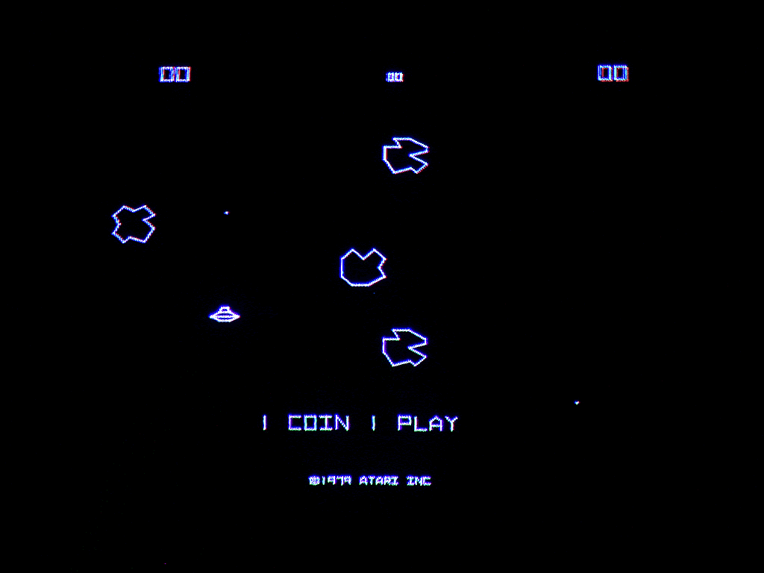

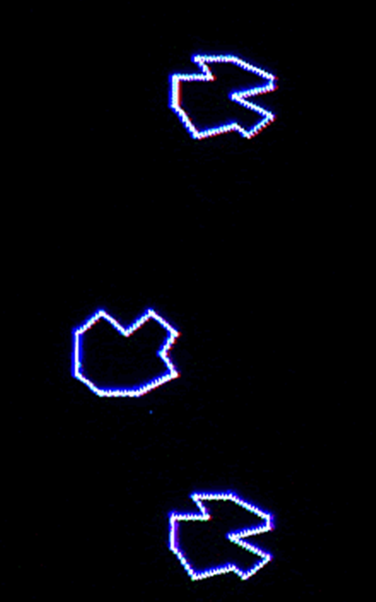


100,000 ASTEROIDS
DOWN THE BACK OF THE COUCH
100,000 ASTEROIDS
DOWN THE BACK OF THE COUCH
CS182 – ARTIFICIAL INTELLIGENCE
30 NOVEMBER 2017

Slide 2


PREPARED BY
MATT HOLMAN
PAUL BLANKLEY
RYAN JANSSEN
WITH MATT PAYNE,
Minor Planet Center
PREPARED BY
MATT HOLMAN
PAUL BLANKLEY
RYAN JANSSEN
WITH MATT PAYNE,
Minor Planet Center
CS182 – ARTIFICIAL INTELLIGENCE
30 NOVEMBER 2017

Slide 3
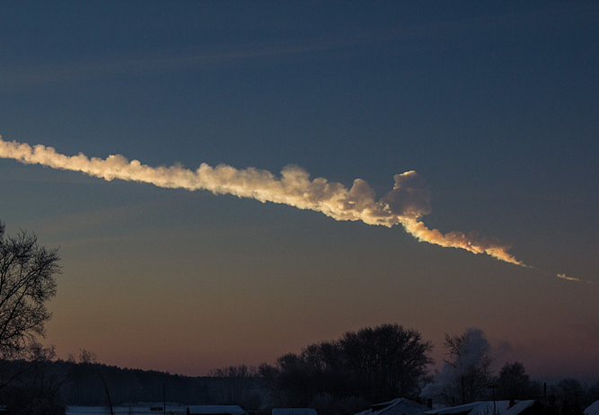
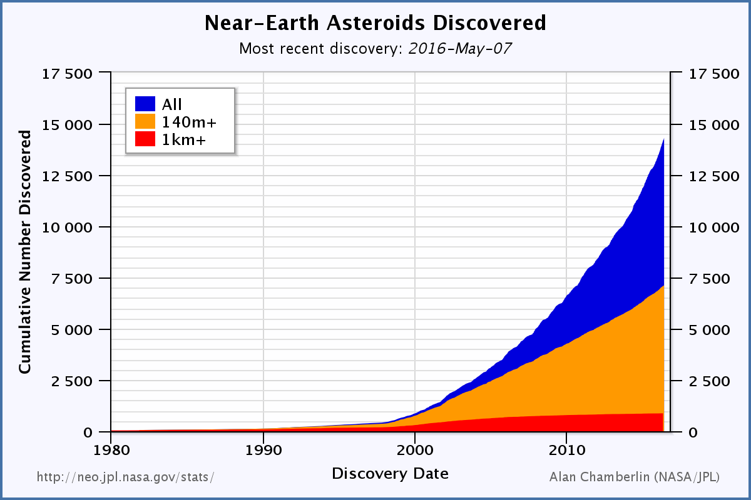
MISSING ASTEROIDS!
CONNECTING ASTEROID TRACKLETS
Mandate from Congress:
Discover >90% of potentially hazardous asteroids with diameters >140 meters
Currently, we have 170m asteroid observations

Slide 4
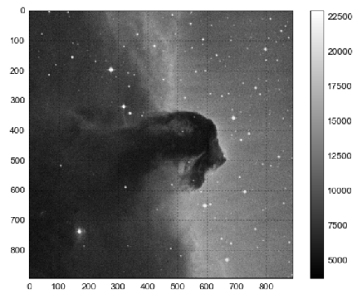
MISSING ASTEROIDS!
CONNECTING ASTEROID TRACKLETS
Asteroid ‘tracklets’ are found by matching 3+ detections in digital exposures
90% can be identified immediately. But there are 14 million unmatched tracklets
Growing quickly as telescope aperture increases

Slide 5
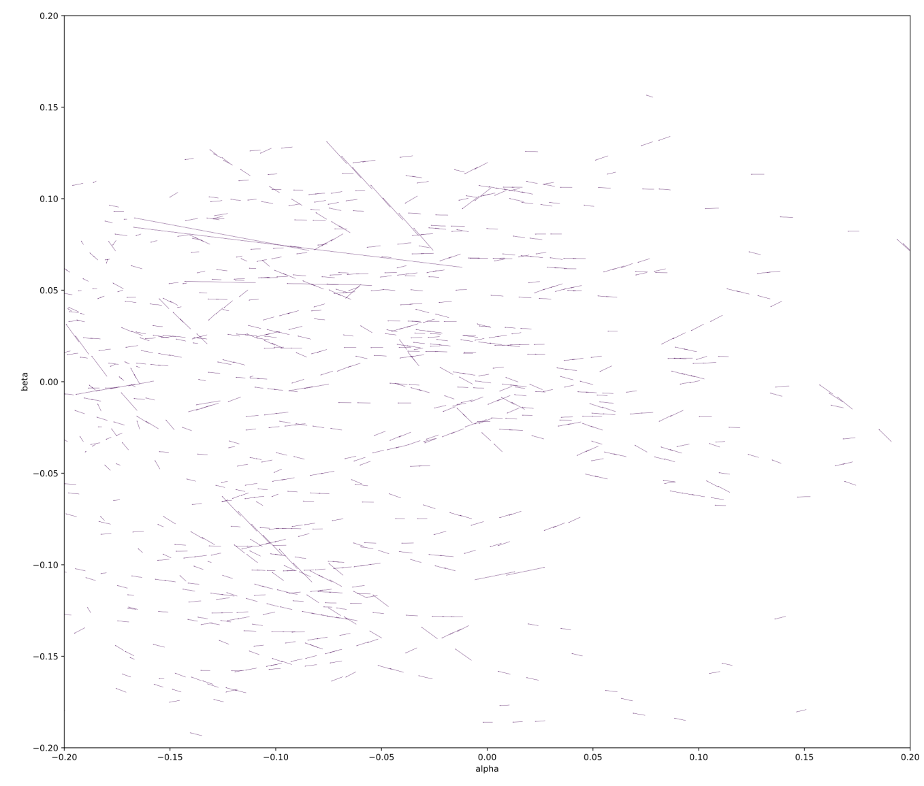

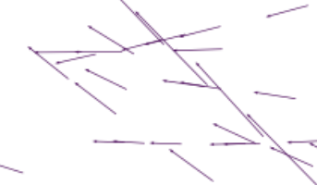
A HARD PROBLEM…
Asteroid tracklets (from Earth’s perspective)
Observed from Earth, asteroid trajectories are highly nonlinear
This, with the high density of asteroids makes naïve linking difficult
Missing data (cannot tell asteroid pos’n/velocity in the radial direction)
Sparse observations can be separated by weeks, months, or years
Brute force is impractical with 14m observations (Current soln = O(n³)!

Slide 6
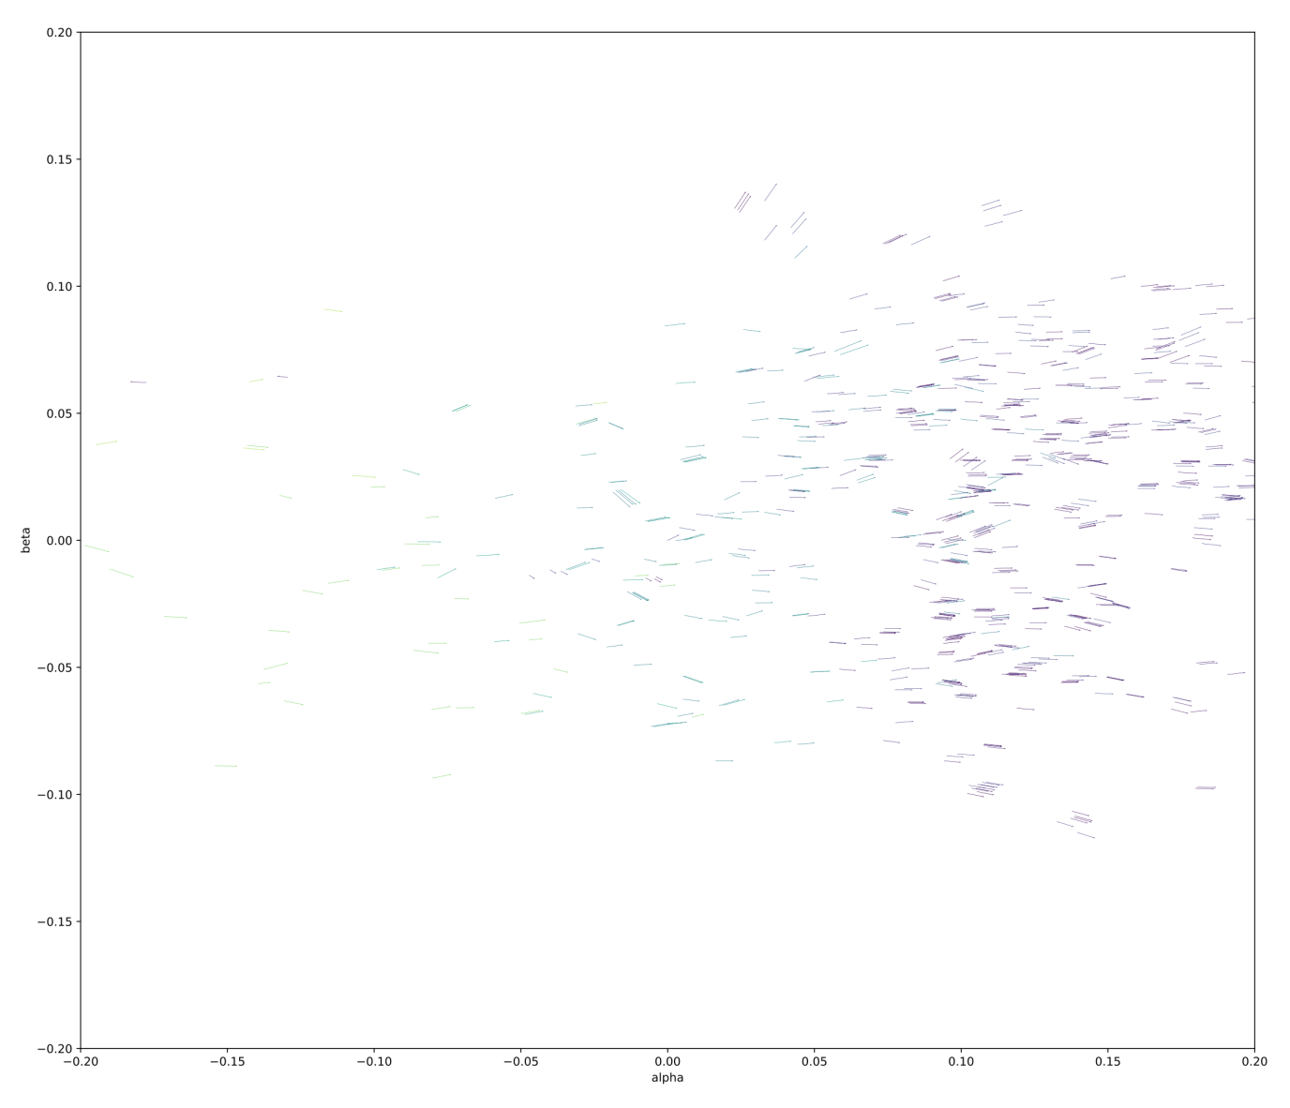
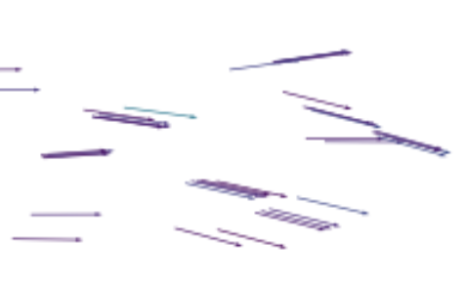
PROPOSED
SOLUTION
Asteroid tracklets (from the Sun’s perspective)
When we apply a heliocentric transformation, the trajectories become clear!
Similar to applying the kernel trick from 2d to 3d space
Can then set a ‘focal distance’ by scanning radial distances/velocities

Slide 7
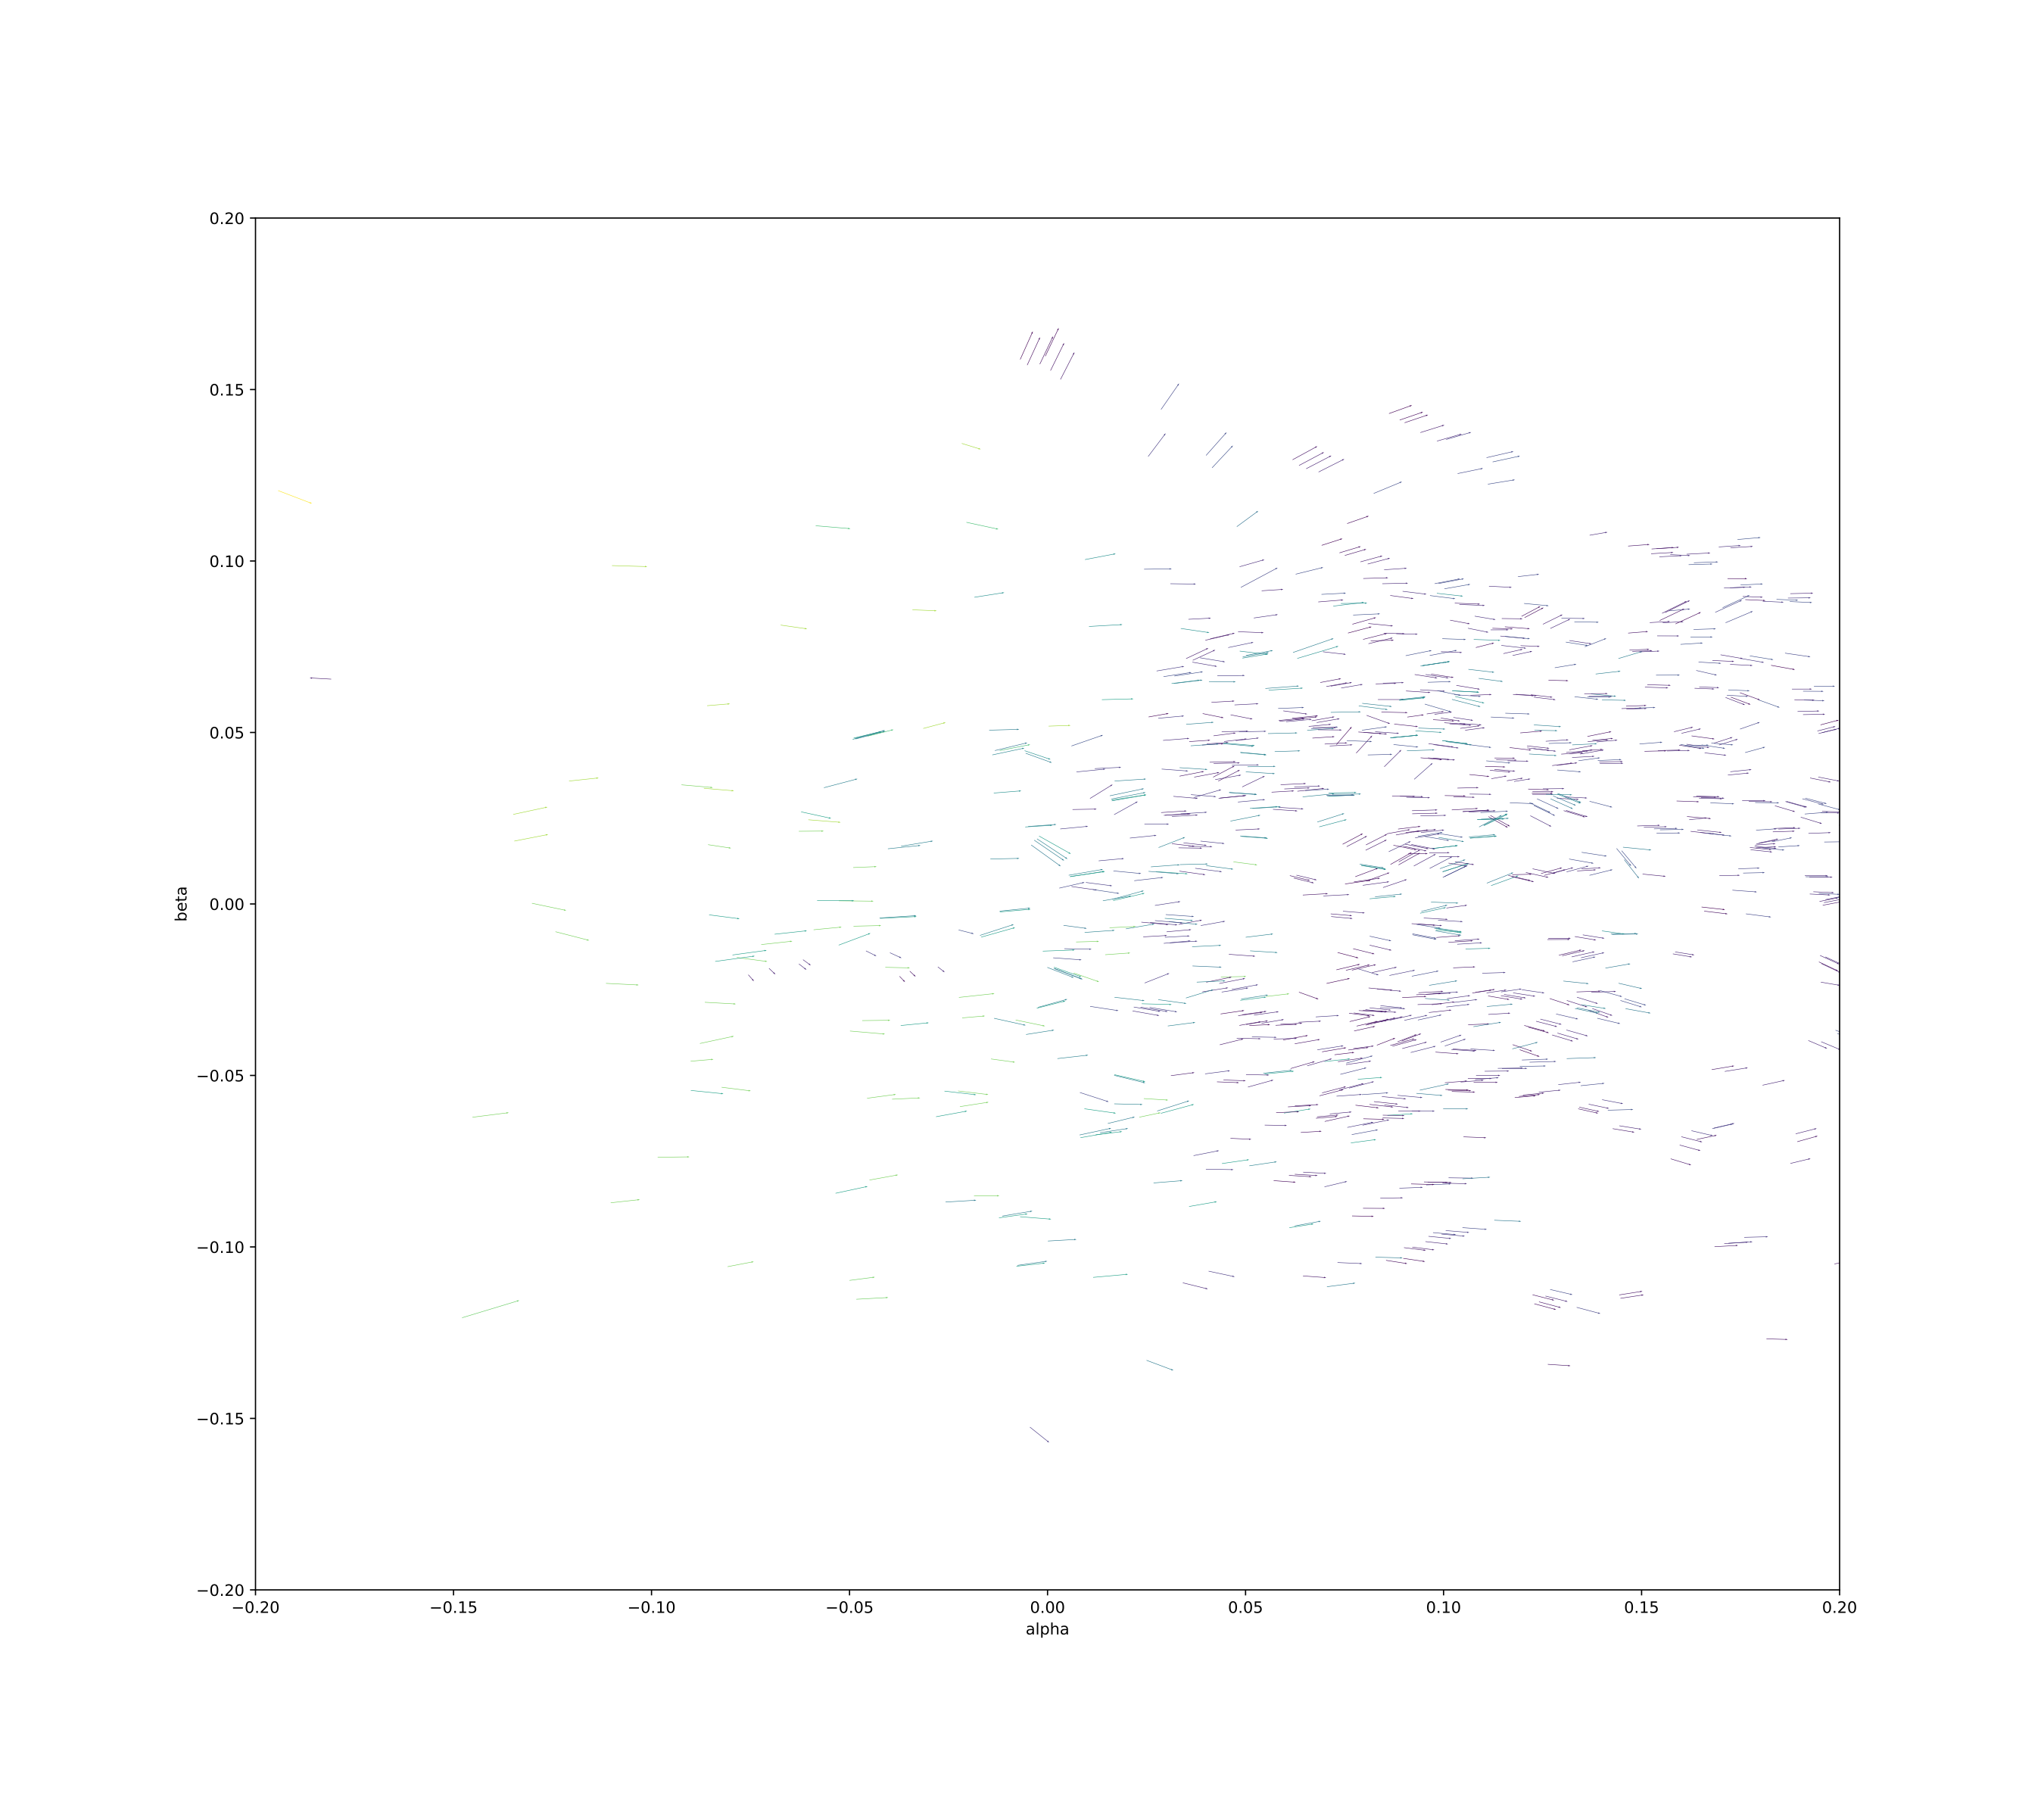
THE VIEW FROM THE SUN

Slide 8
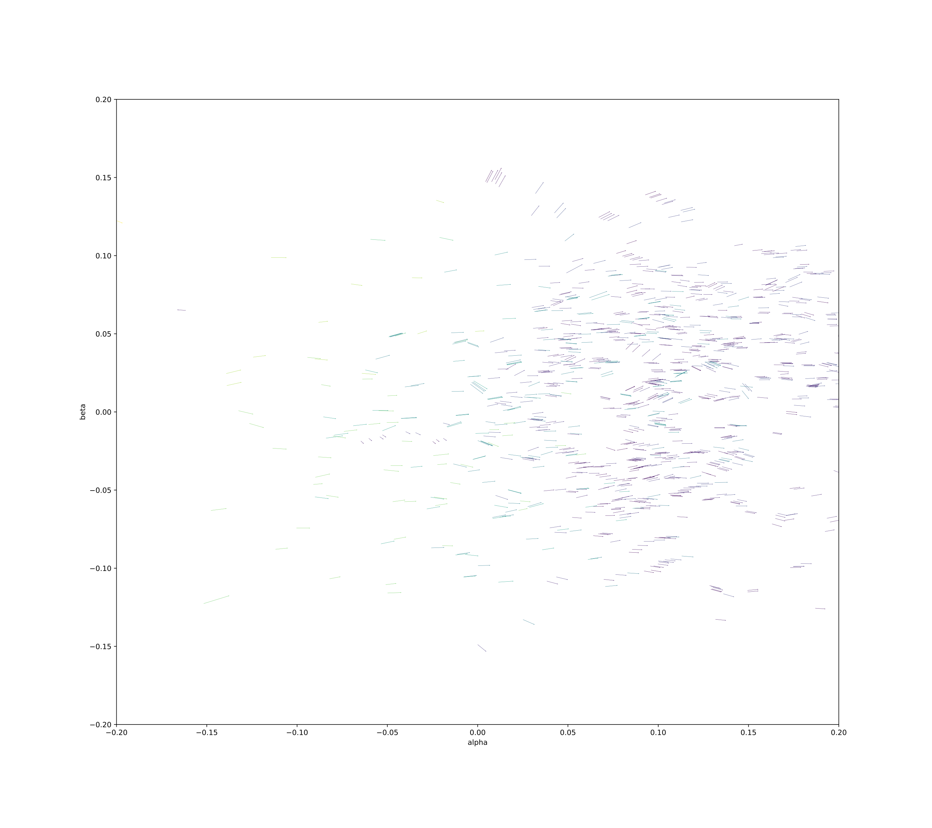
THE VIEW FROM THE SUN

Slide 9
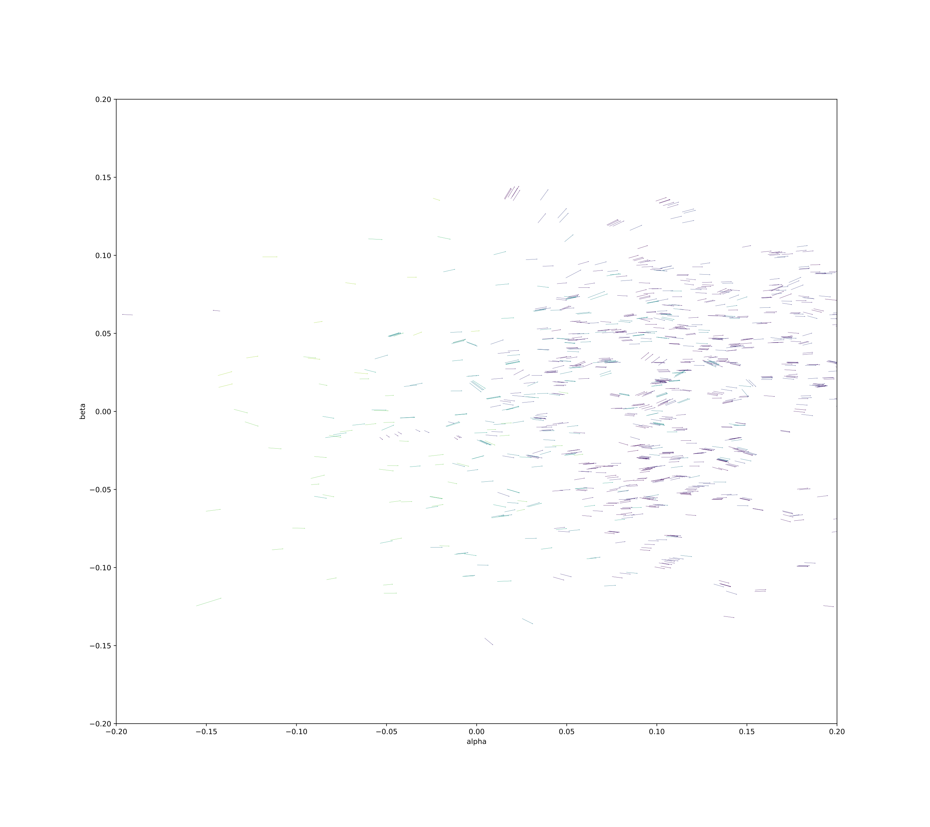
THE VIEW FROM THE SUN

Slide 10
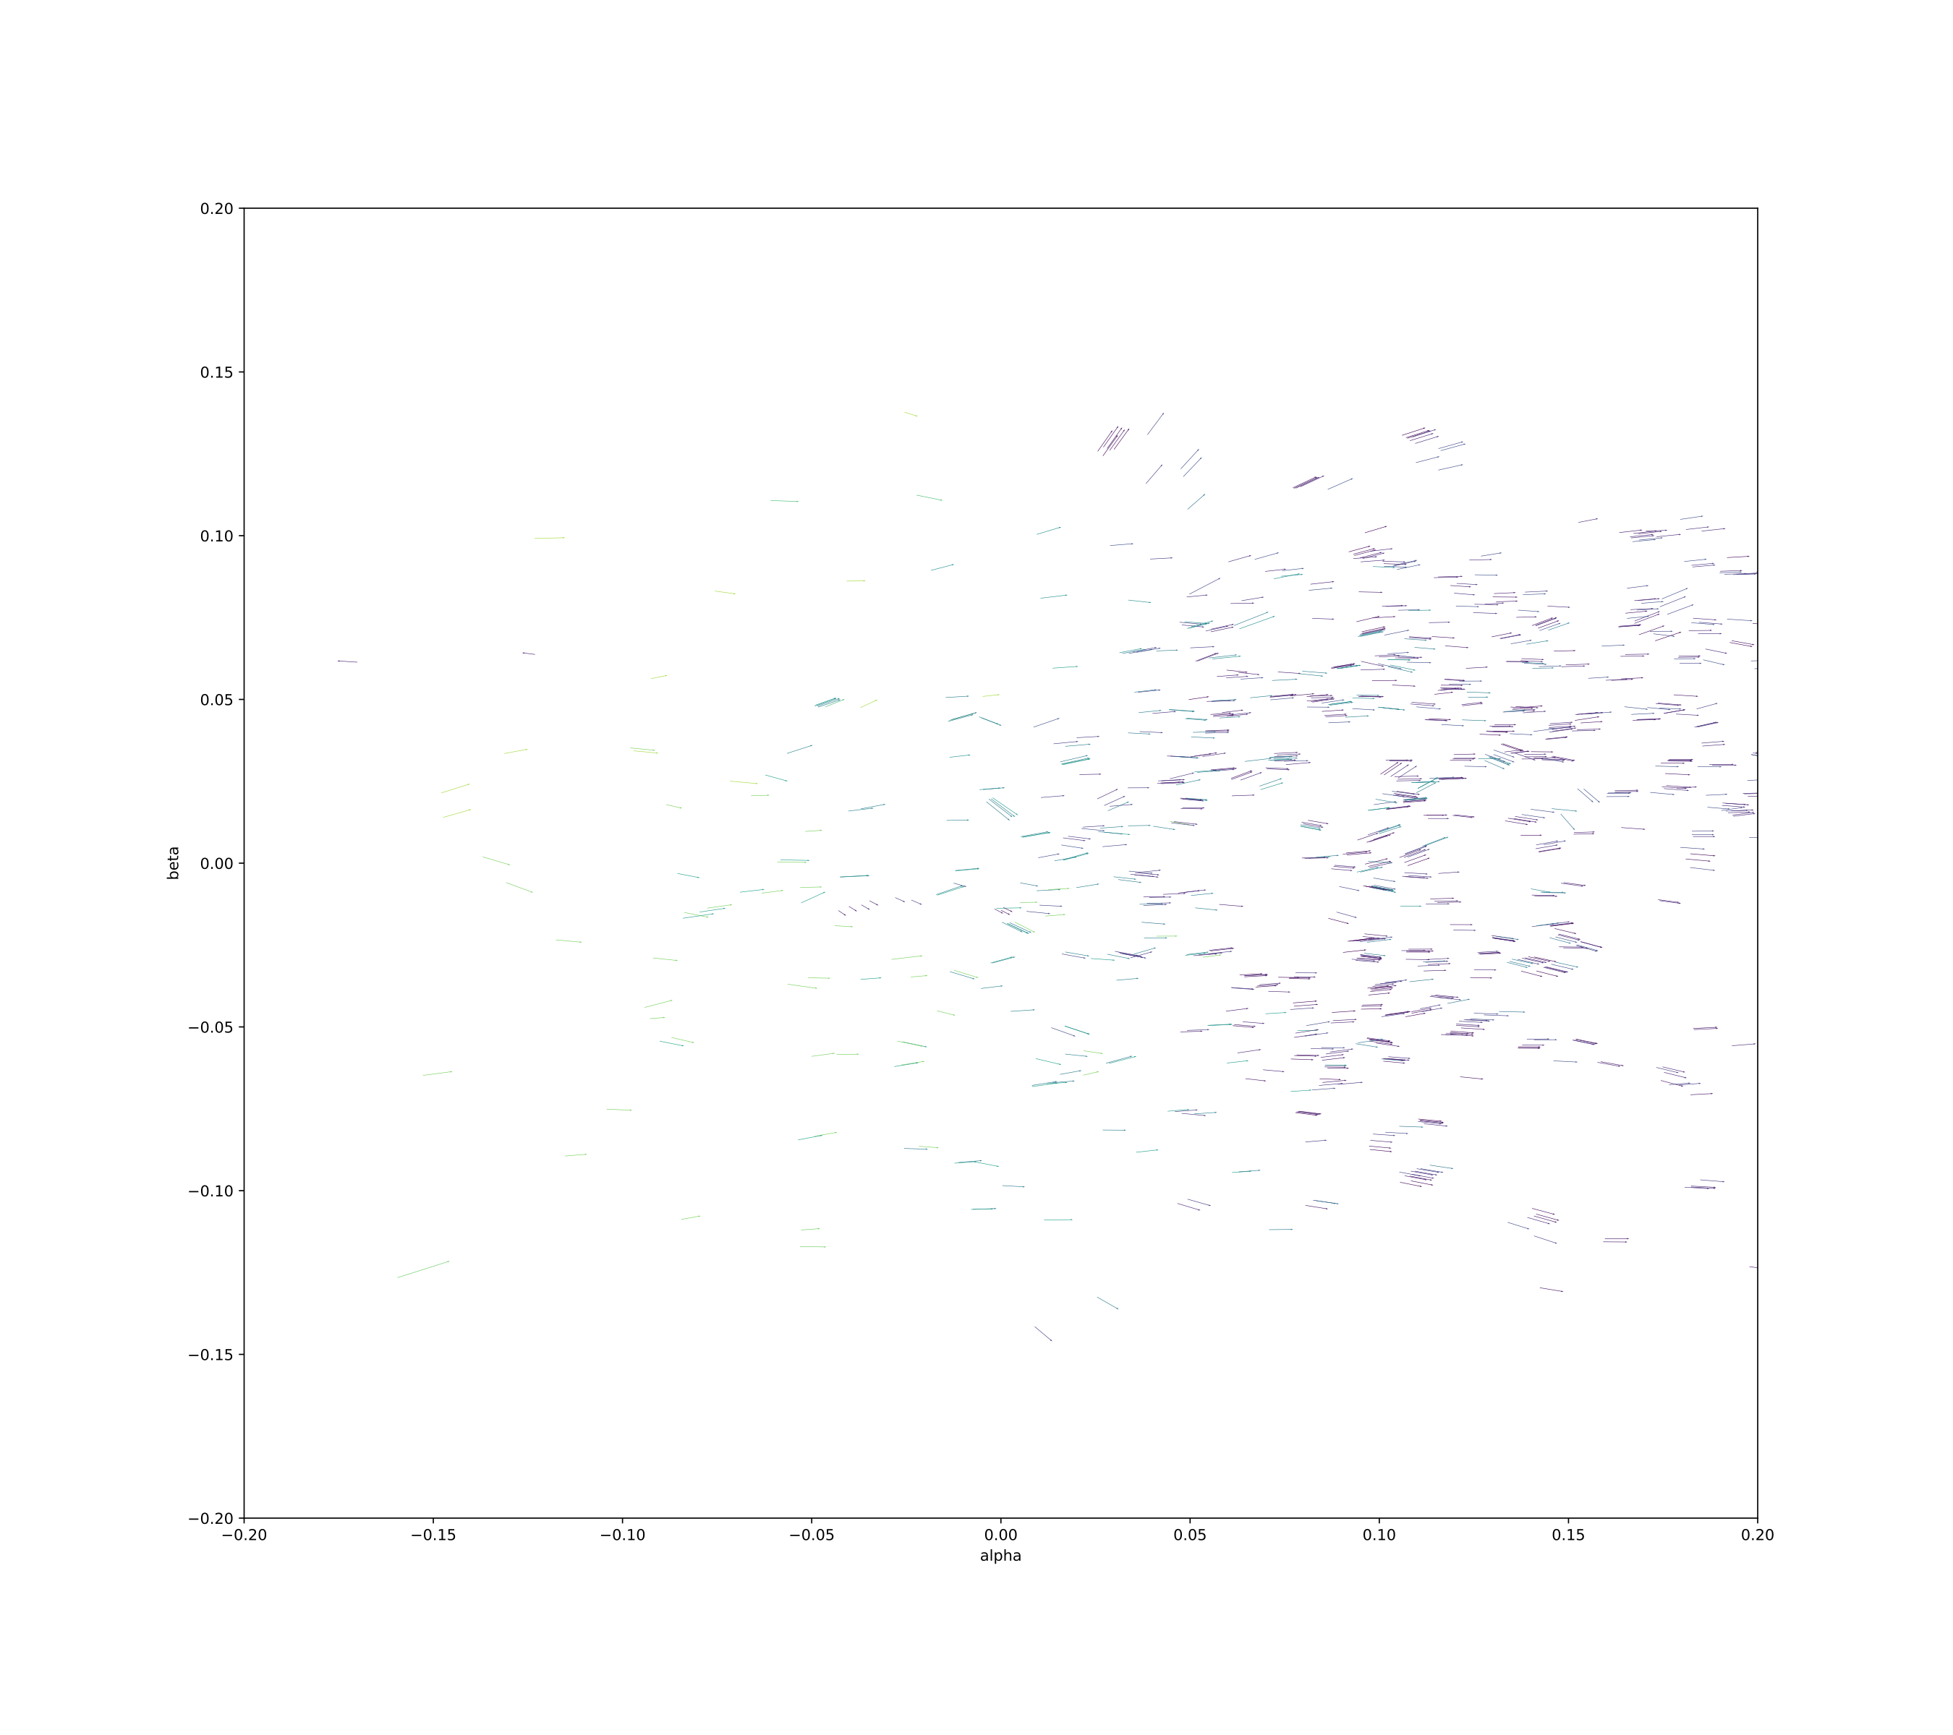
THE VIEW FROM THE SUN

Slide 11
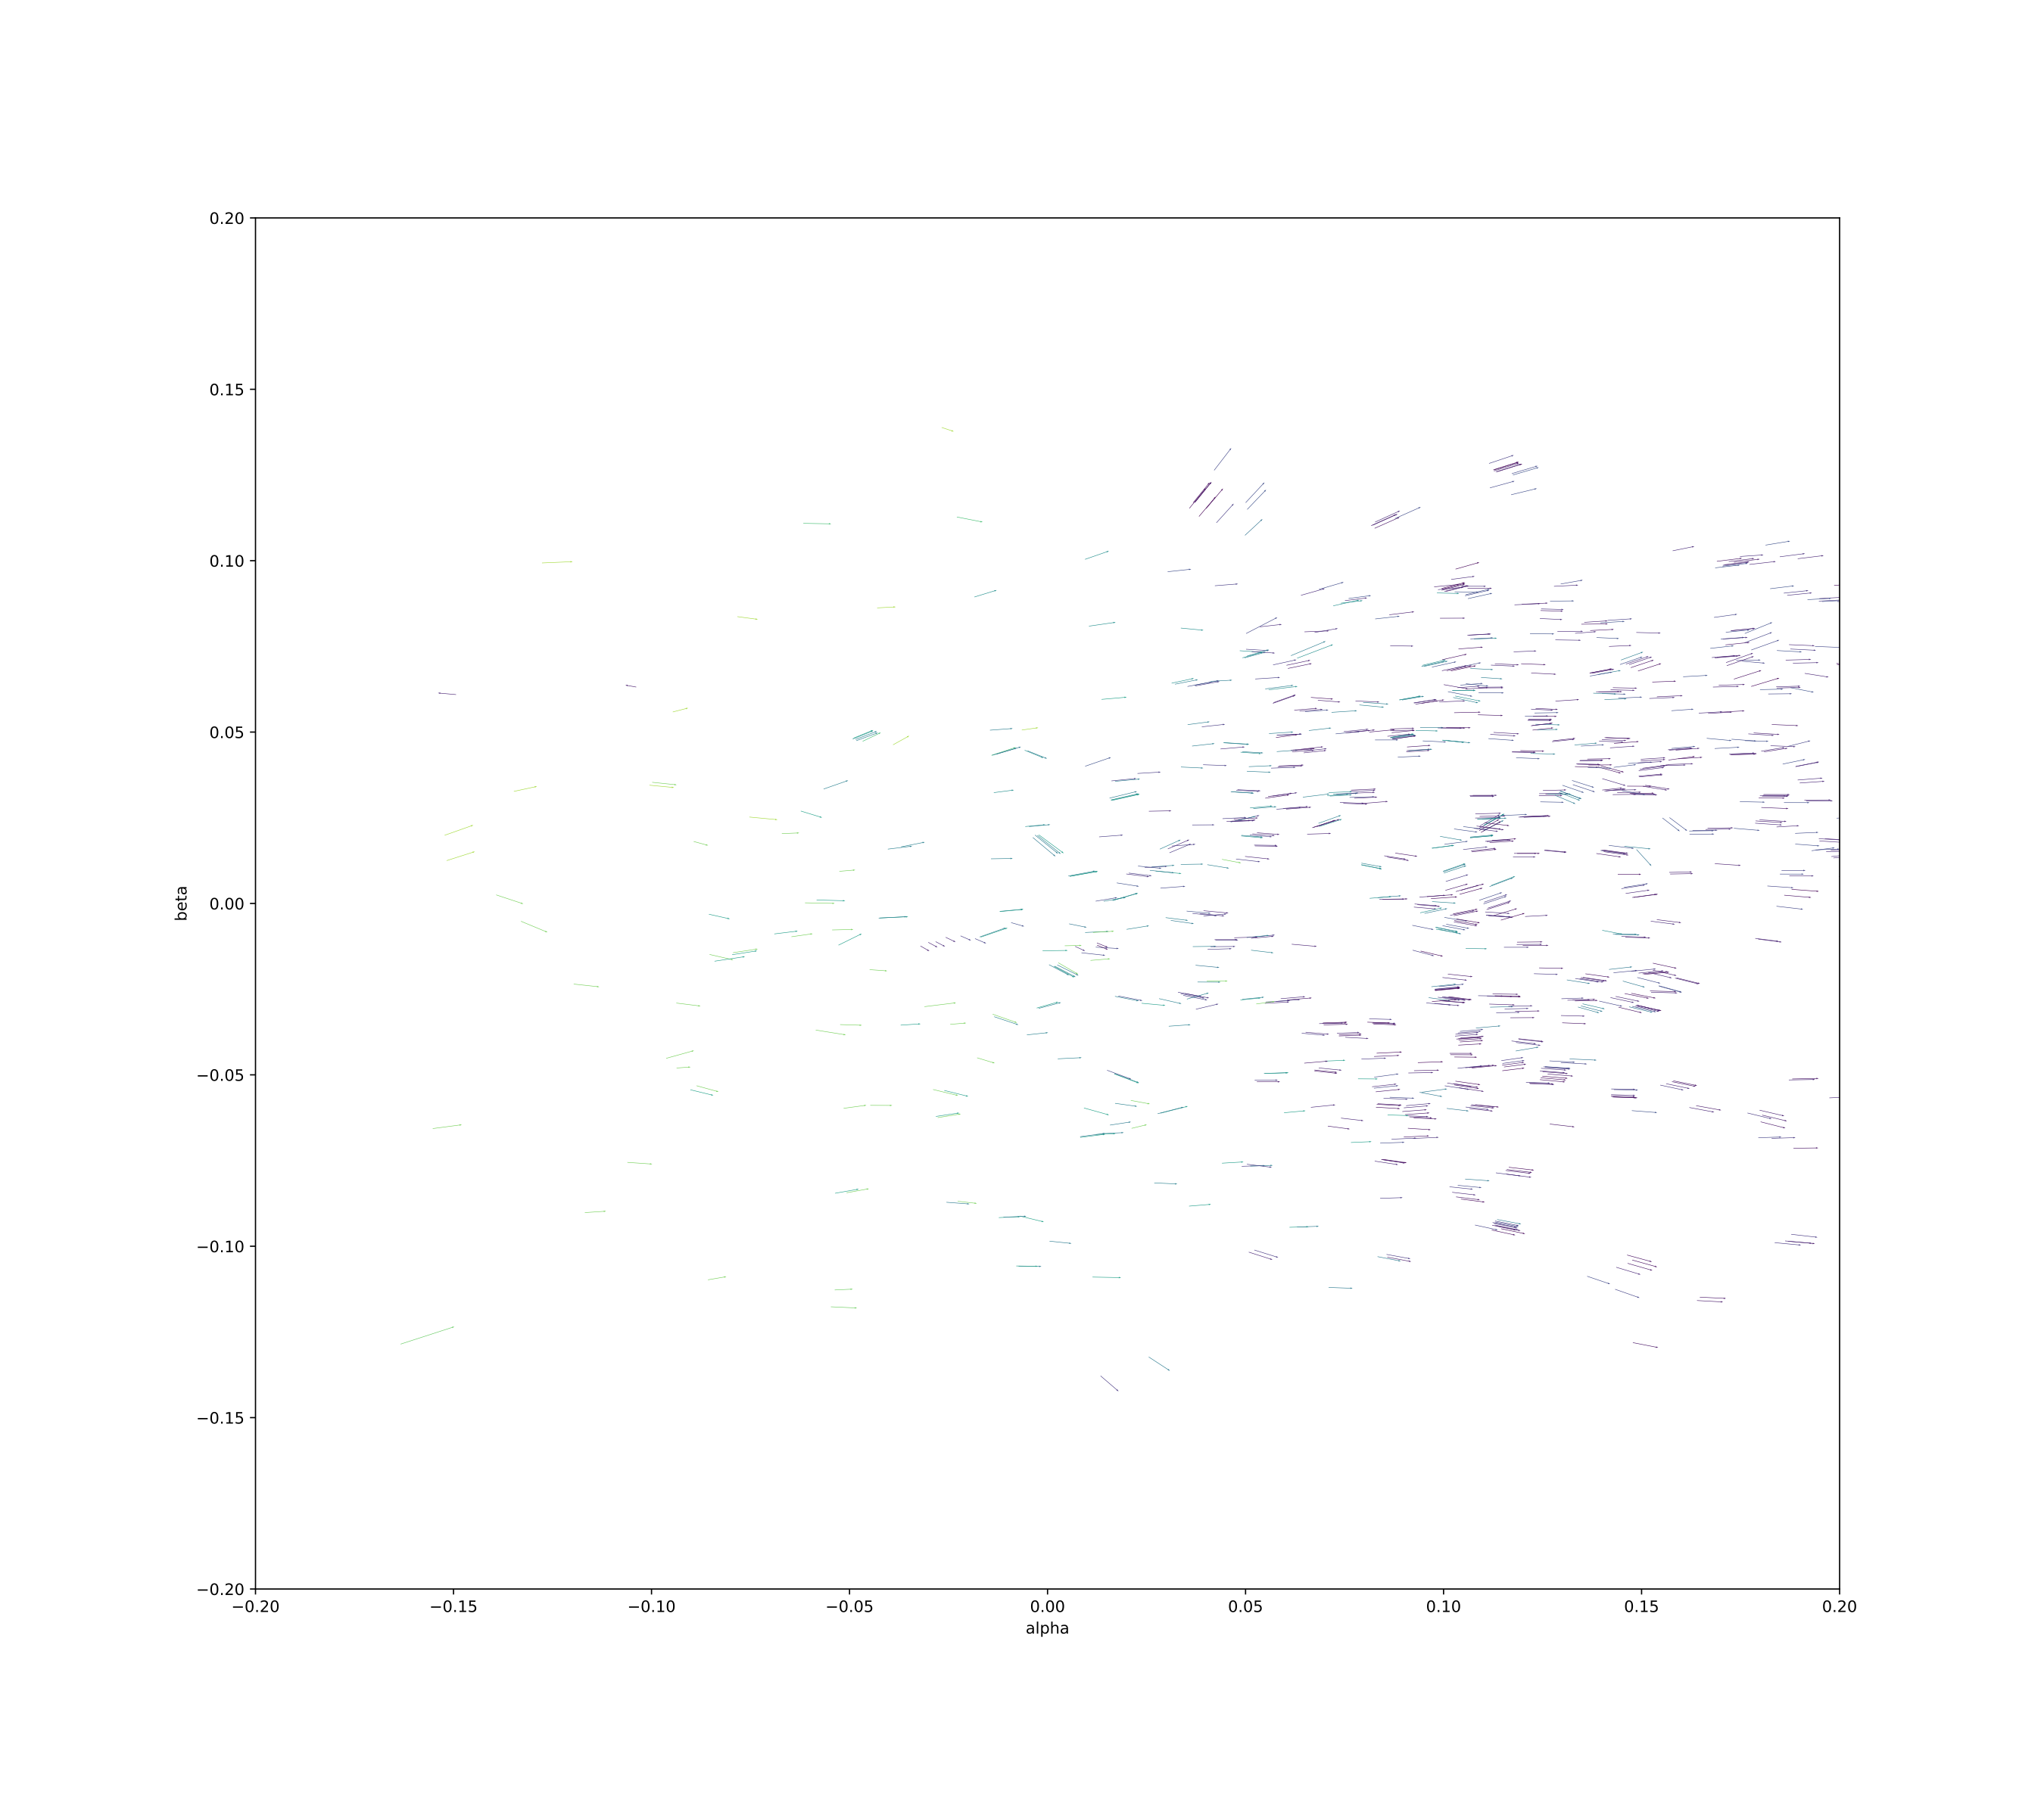
THE VIEW FROM THE SUN

Slide 12
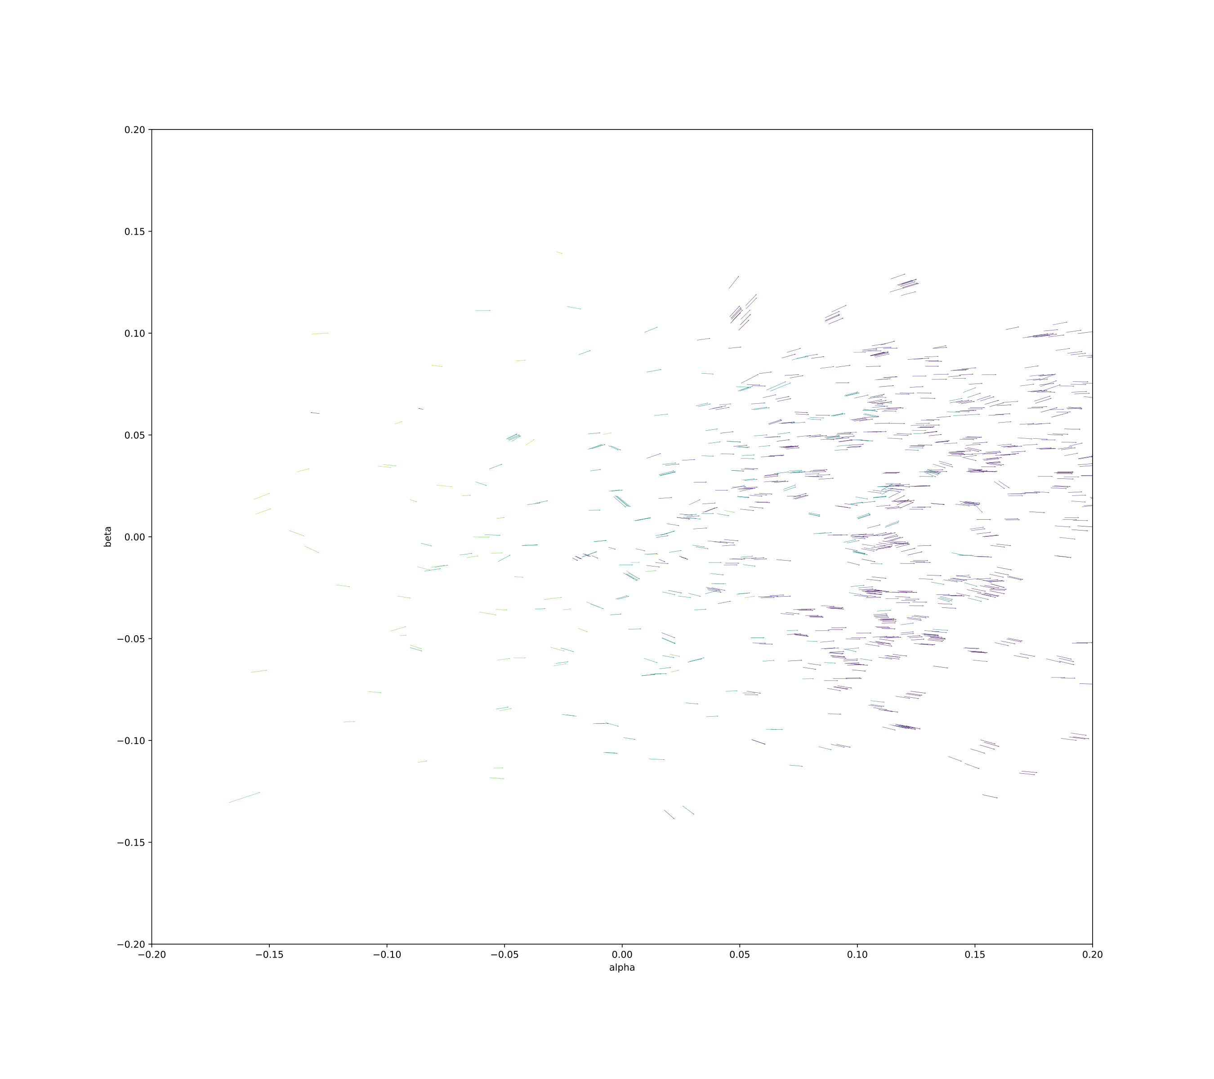
THE VIEW FROM THE SUN

Slide 13
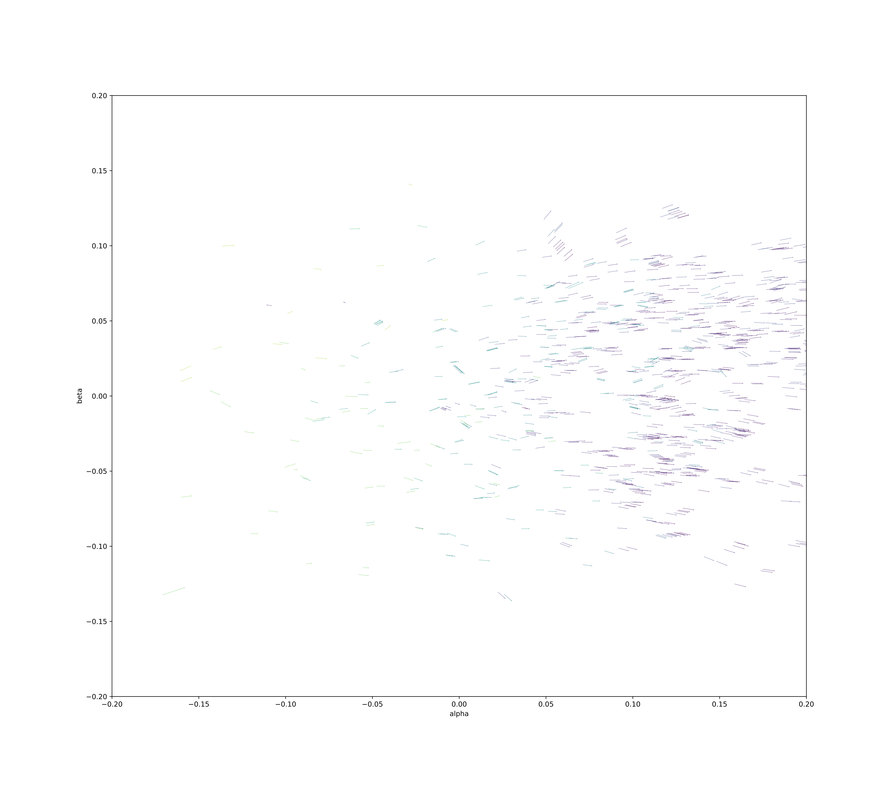
THE VIEW FROM THE SUN

Slide 14



CORE INTUITION
WHY DOES HELIOCENTRIC LINKING WORK?
Heliocentric transformation allows us to infer a near-constant distance from the sun
(we have a strong prior)
Also helps us compare asteroid tracklets in a linear space, at a common time
Enables clustering to identify observations as one object
Earth POV (nonlinear)
unknown
unknown, but:
inferable
~constant
Heliocentric POV (~linear)
known
Earth is moving faster
than the asteroid!
*not to scale
(…obviously)

Slide 15
OUR METHODOLOGY
Dividing into sky regions allows for a more precise clustering
1.
DIVIDE SKY INTO 300 MONTHLY TIME SLICES, 800 SKY REGIONS
2.
ASSERT THE (UNKNOWN)
RADIAL DISTANCE FROM THE SUN

Slide 16
OUR METHODOLOGY
1.
DIVIDE SKY INTO 300 MONTHLY TIME SLICES, 800 SKY REGIONS
4 of our 6 motion parameters are known, and 1 is relatively constant
Model is linear in the parameters (least squares fit)
2.
ASSERT THE (UNKNOWN)
RADIAL DISTANCE FROM THE SUN
3.
ITERATE OVER RADIAL VELOCITIES, FIT FOR OTHER MOTION PARAMS
4.
CLUSTER BASED ON RESULTING PARAMS: X/Y/Z POSITION, VELOCITY

Slide 17
OUR METHODOLOGY
TUNE CLUSTERING HYPERPARAMETERS OVER KNOWN TRAINING SET (THANKS TO MATT PAYNE, MINOR PLANET CENTER!)
TRAIN CLUSTER RADIUS/WEIGHTING
1.
DIVIDE SKY INTO 300 MONTHLY TIME SLICES, 800 SKY REGIONS
We tune two hyper-parameters:
1) OPTIMAL
CLUSTER RADIUS
2) WEIGHTING OF
VELOCITY VS.
POSITION
2.
ASSERT THE (UNKNOWN)
RADIAL DISTANCE FROM THE SUN
3.
ITERATE OVER RADIAL VELOCITIES, FIT FOR OTHER MOTION PARAMS
4.
CLUSTER BASED ON RESULTING PARAMS: X/Y/Z POSITION, VELOCITY

Slide 18
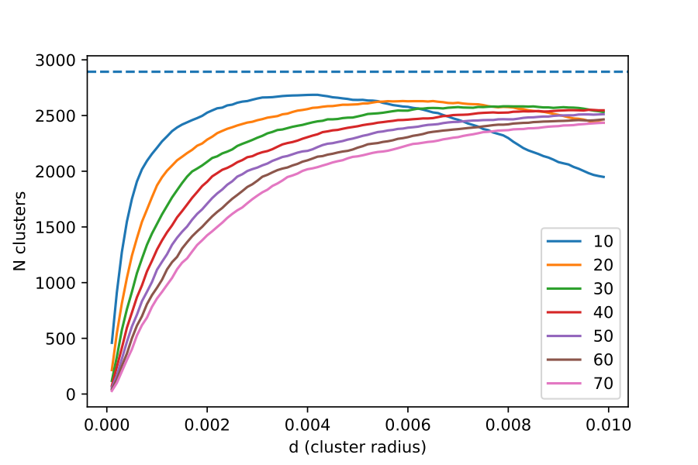
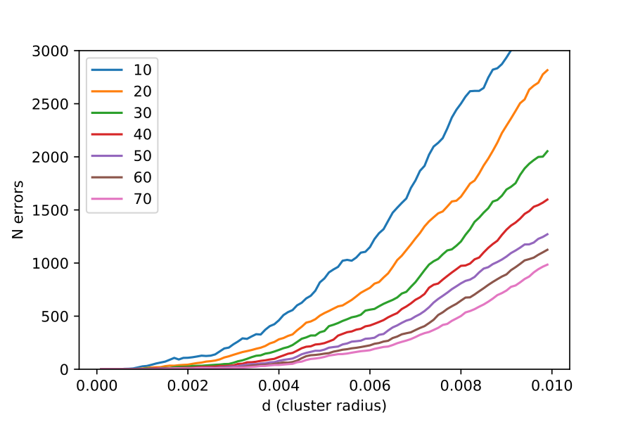
Total clusters detected vs. KD-tree cluster radius (training set)
TUNING PERFORMANCE
OPTIMAL RADIUS:
0.0005-0.0010 radians
Error rate vs. KD-tree cluster radius (training set)
Selected KD-tree clustering for speed (average case log(n))
Also had good results with agglomerative clustering

Slide 19
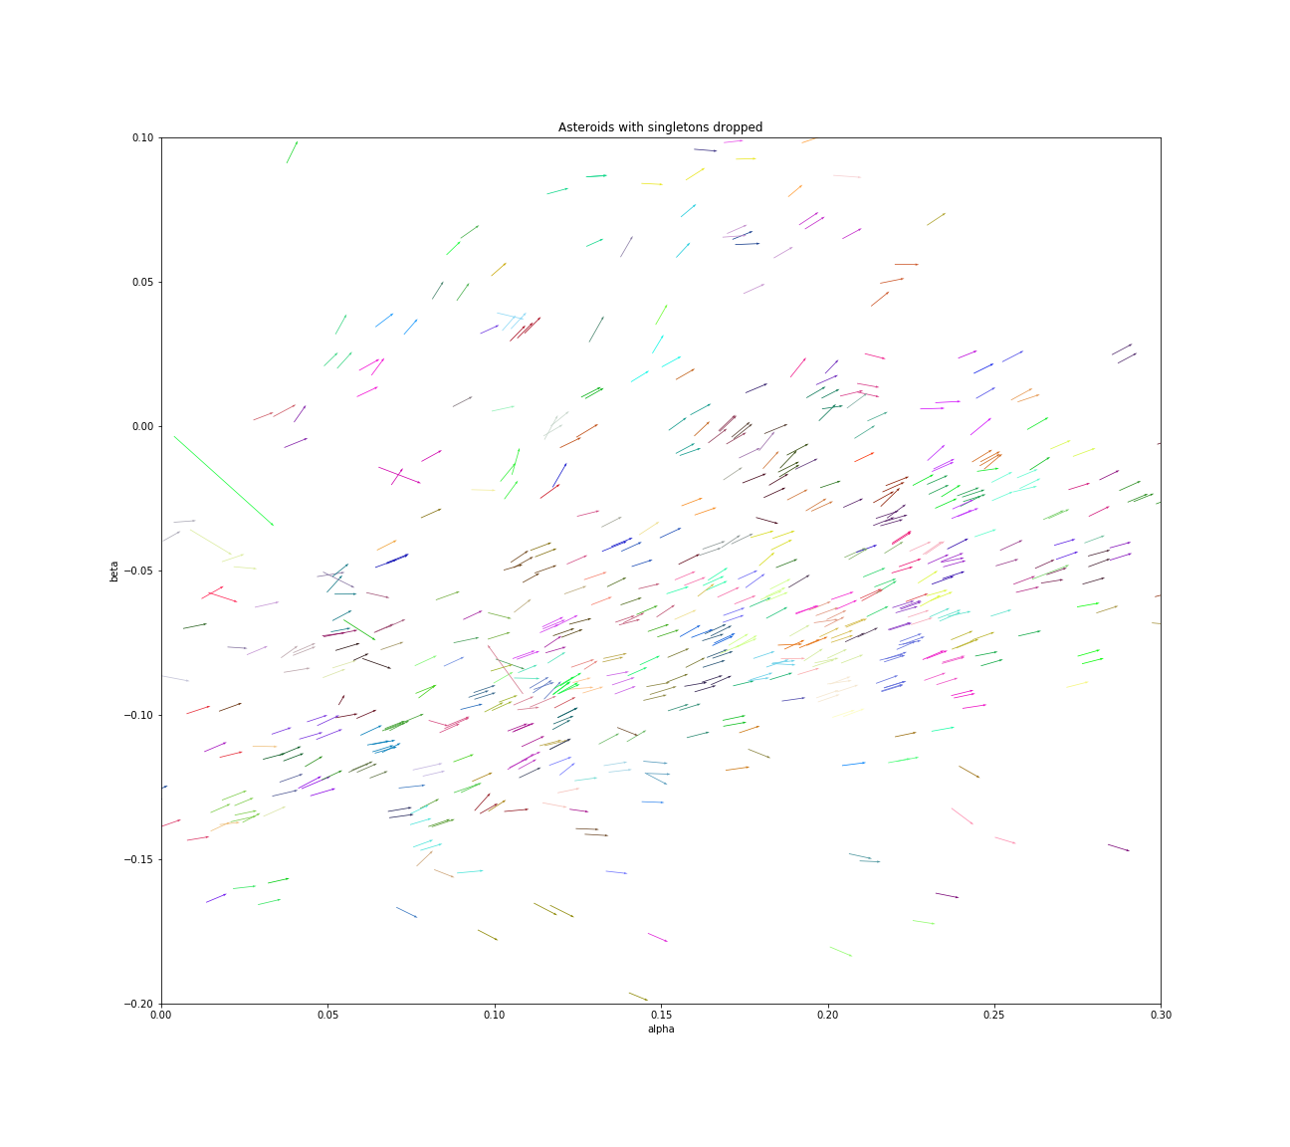
CLUSTERING RESULTS
90% OF ASTEROIDS DETECTED
WITH NEAR-ZERO ERROR!
Identified Asteroids (common colors = a single asteroid)

Slide 20

CONCLUSIONS
Conclusion: Strong tracklet linking with heliocentric transformation & KD-tree clustering
Also able to do so in just O(n log n) time, a scalable solution!!
Limitations: currently restricted to small (monthly) observation time window
Next Steps: Run the algorithm over all 14m tracklet observations!
Thanks To: The Minor Planet Center for training data, Scott and Brian for project support!

Slide 22

APPENDIX/SUPPORTING SLIDES

Slide 23
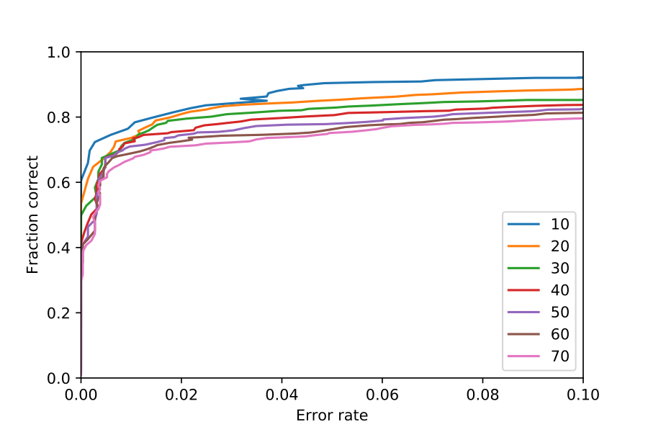
Training AUC

Slide 24
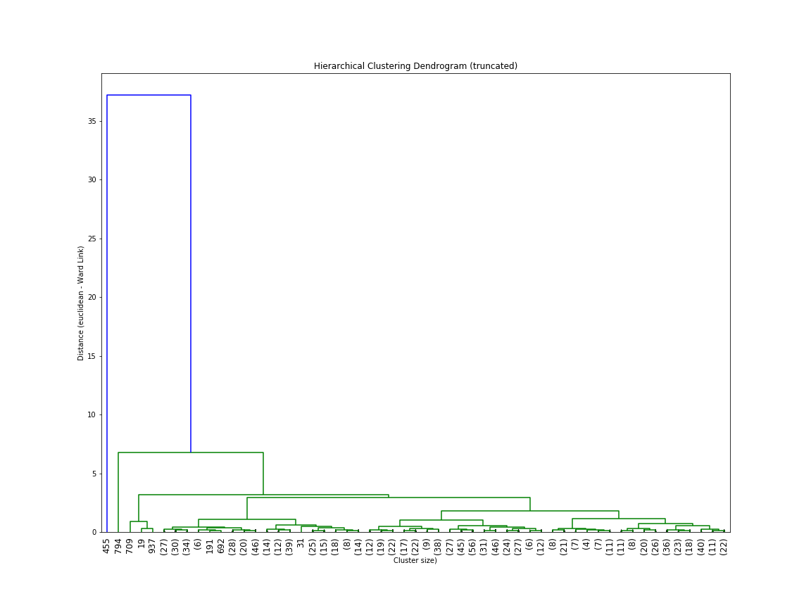
Agglomerative Clustering Dendogram (Truncated)

Slide 25
Total clusters detected vs. KD-tree cluster radius (training set)

Slide 26
Error rate vs. KD-tree cluster radius (training set)

